Slide 1
Enhance YouTube channel
MPC MASR channel

Slide 2
Introduction
This data collected from YouTube Data API [Play lists, Play list items, Videos].
The main objective of analyze this data is to enhance MPC MASR YouTube channel.
By answering on this question What is my audience looking for? And, how am I going to attract that audience.
according to my analysis if found that, most of all popular videos contains words that trigger emotional responses or curiosity.
So, I decided to improve the titles to enhance the channel, because a first look is the most important.

Slide 3
Data Preprocessing
Remove all duplicates and keep first one
Remove duplicates based on play list id and video
Put an empty string in place of each null value in the tags column
Separates date and time into two columns from 'publish_time' column
Encoding of Category data
Log scale to Views, Likes, Dislikes, Comments
Add ‘popular’ column, popular video means the number of views for the video is more than 1.5 interquartile ranges (IQRs) above the third quartile
Add ‘like_percentage’ column

Slide 4
Analysis

Slide 5
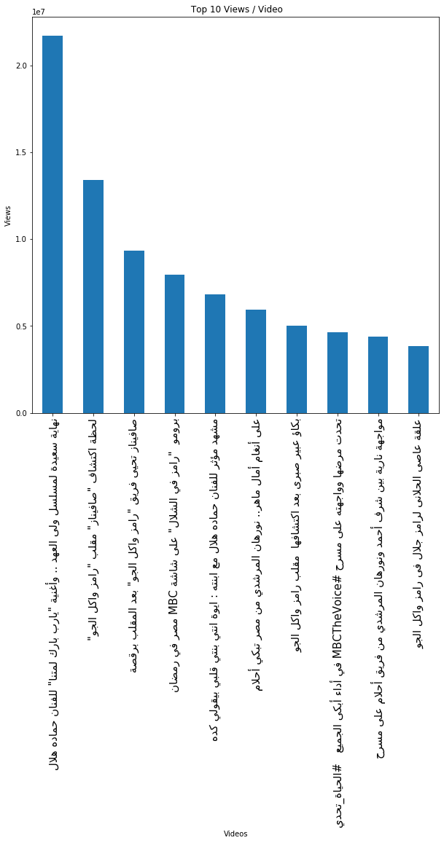
top 10 most views videos

Slide 6
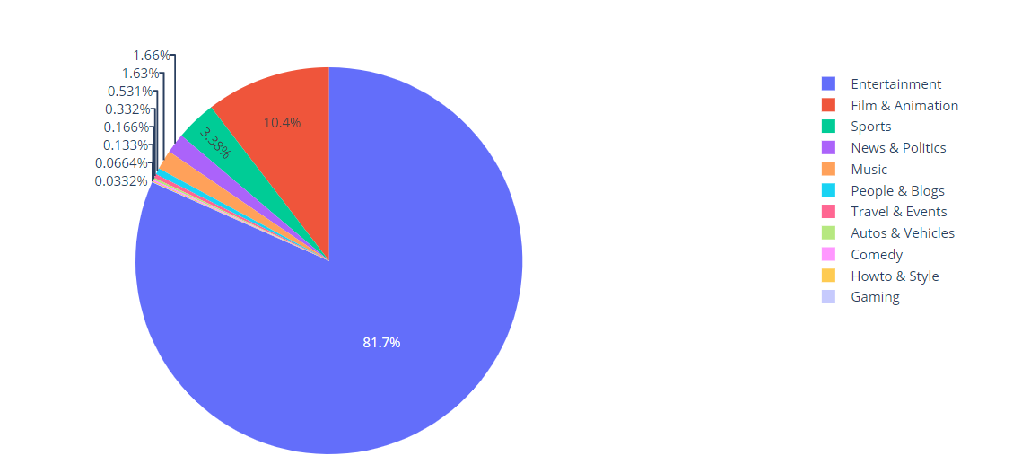
Categories

Slide 7
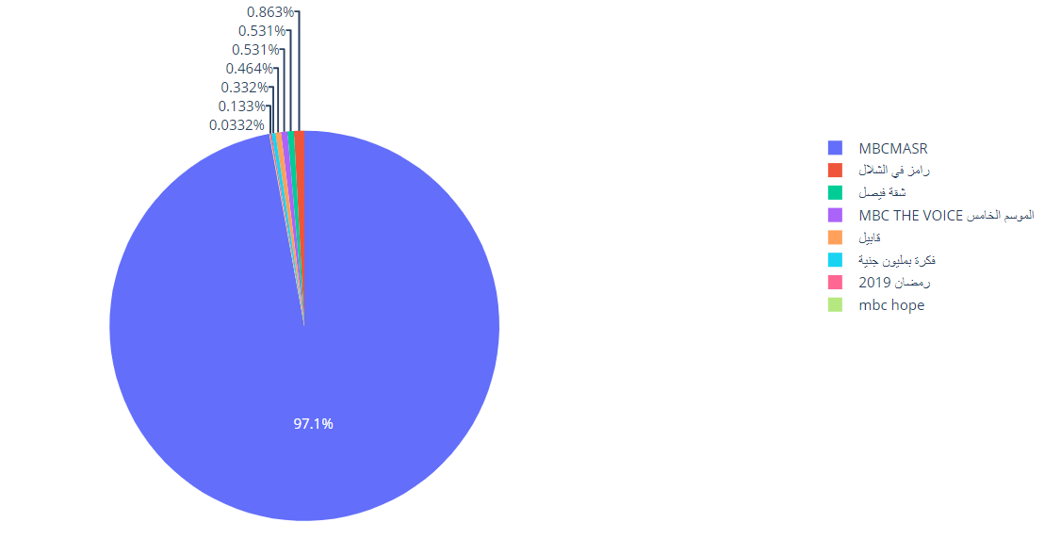
Play lists

Slide 8
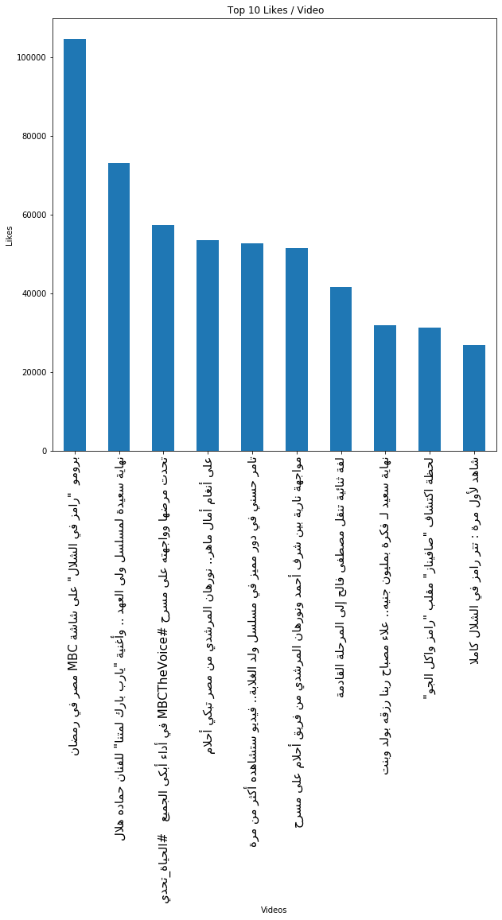
top 10 most liked videos

Slide 9
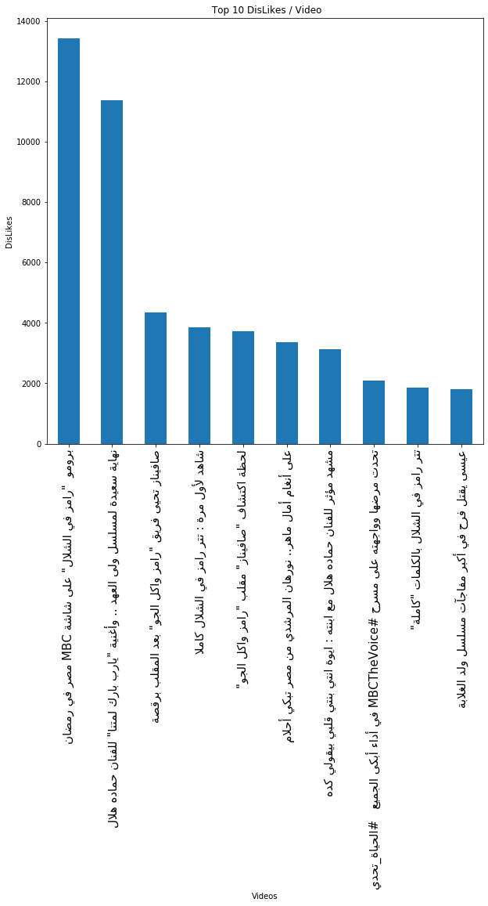
top 10 most disliked videos

Slide 10
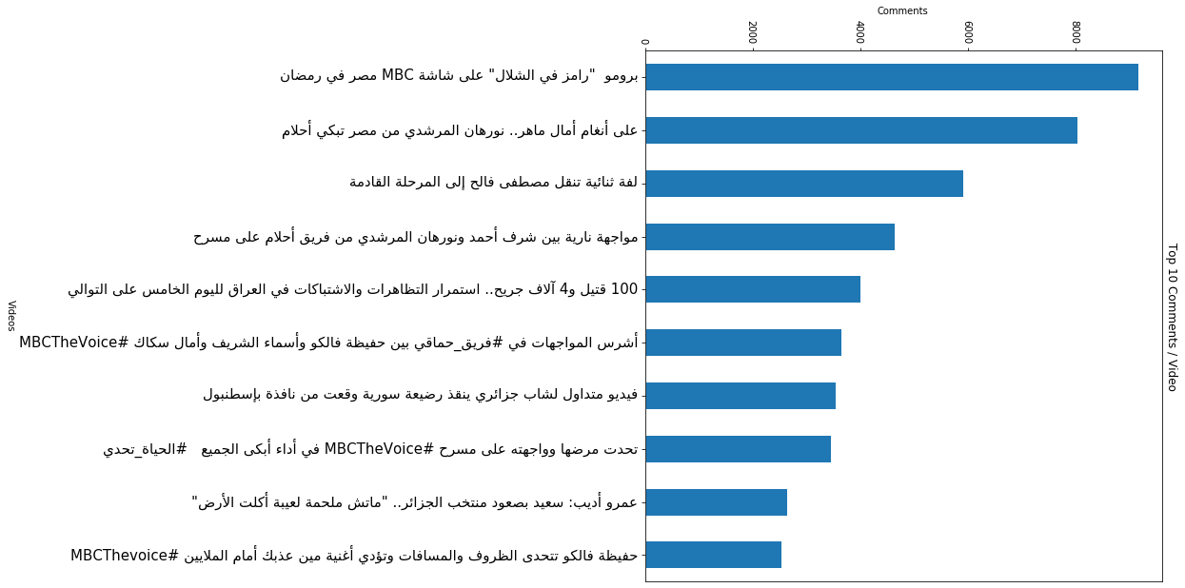
top 10 most commented videos

Slide 11
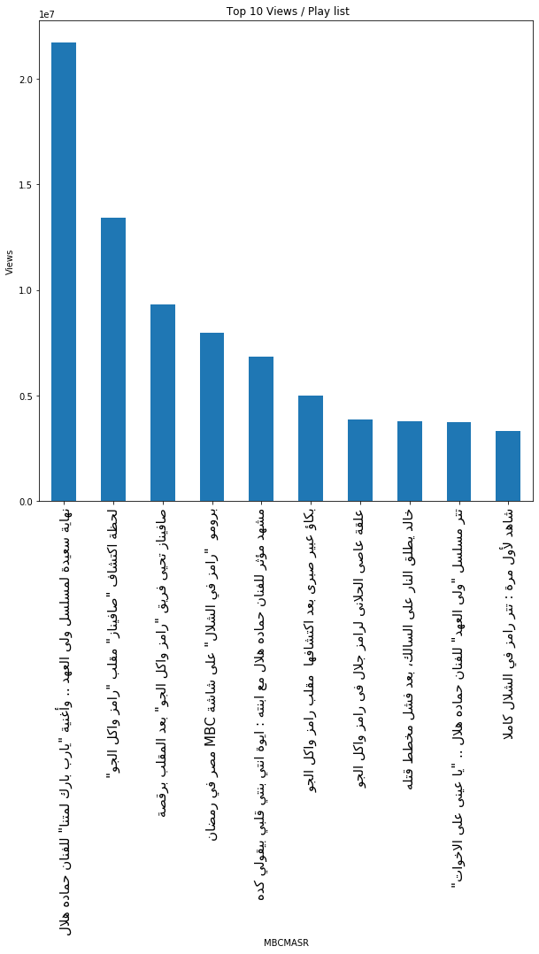
top 10 most views videos on play list MPCMASR

Slide 12
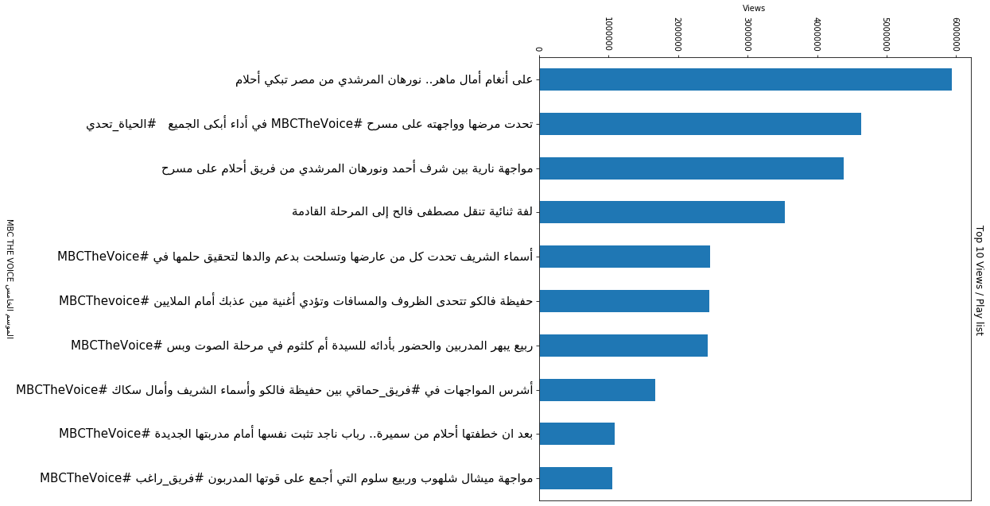
top 10 most views videos on play list MPC The Voice

Slide 13
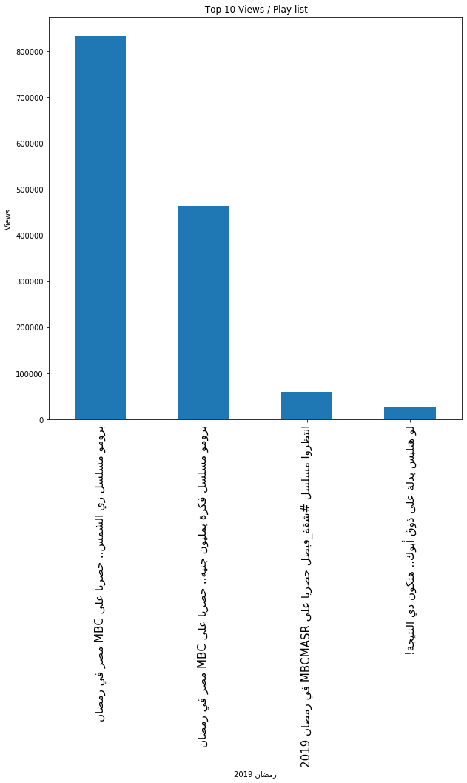
top 10 most views videos on play list رمضان 2019

Slide 14
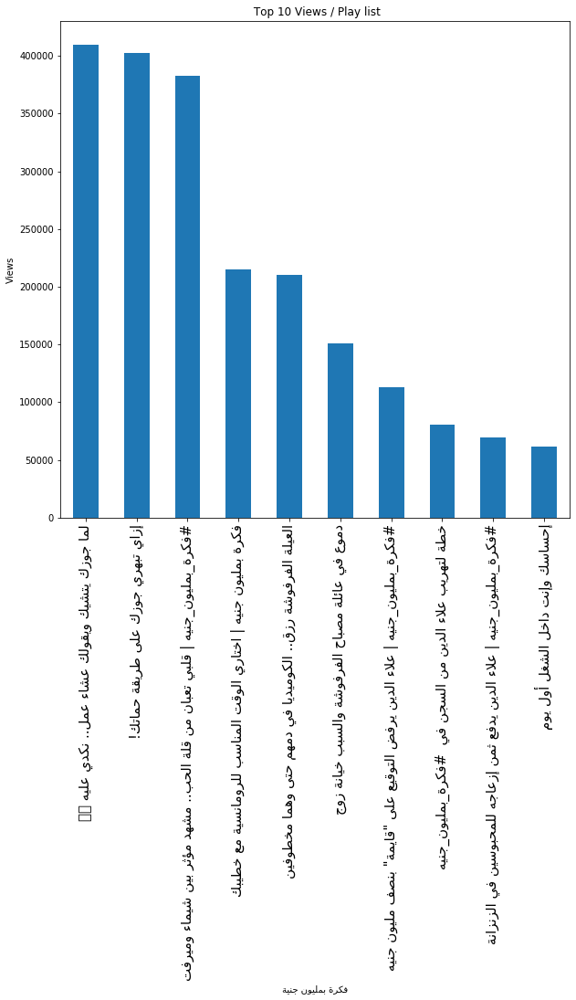
top 10 most views videos on play list فكرة بمليون جنية

Slide 15
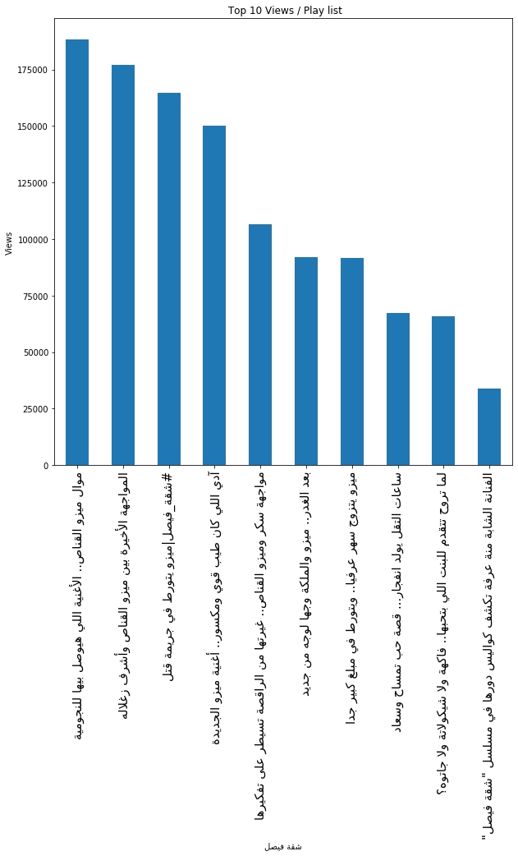
top 10 most views videos on play list شقة فيصل

Slide 16
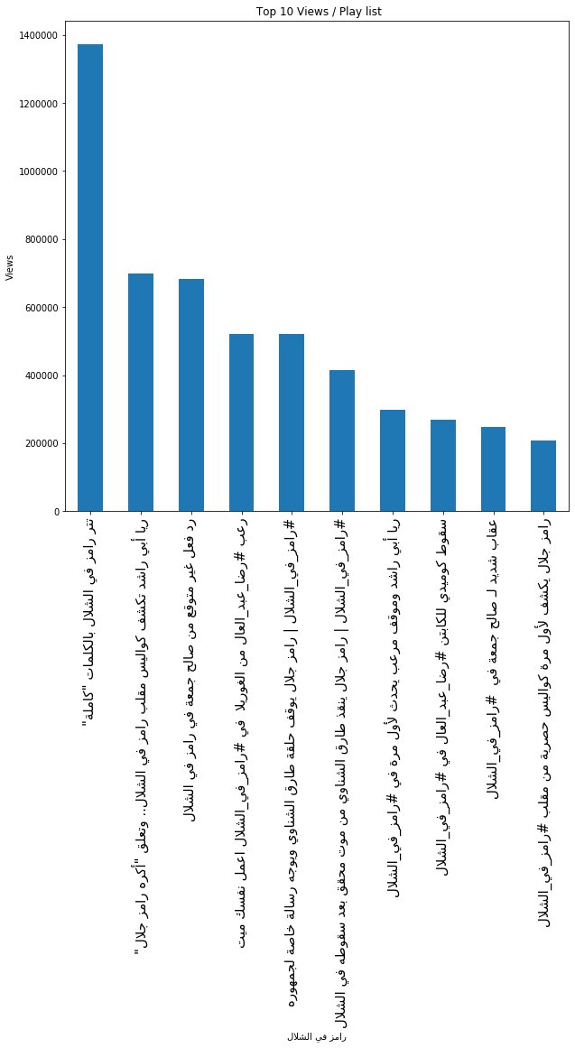
top 10 most views videos on play list رامز فى الشلال

Slide 17
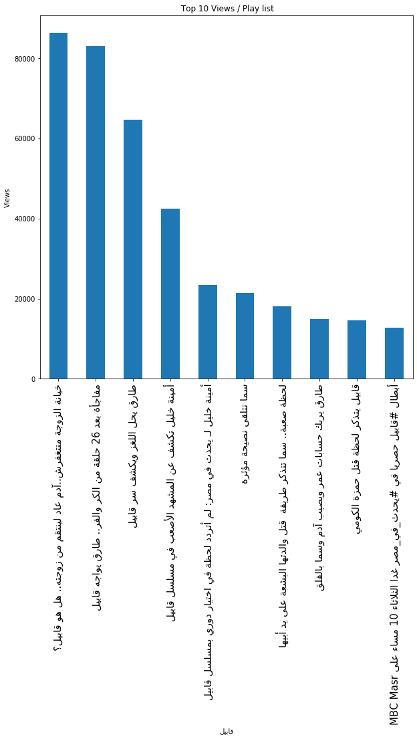
top 10 most views videos on play list قابيل

Slide 18
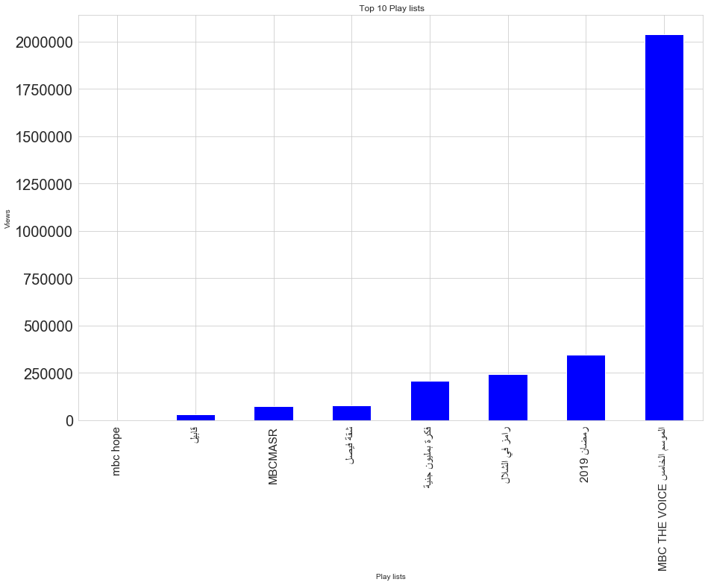
top 10 most views videos on play list قابيل

Slide 19
According to all analysis of all videos based on views, comments, likes, dislikes I found most of all videos contains words that trigger emotional responses or curiosity to famous, normal people or for general situations attract more audience.

Slide 20
Closer look on Titles of Popular Videos

Slide 21
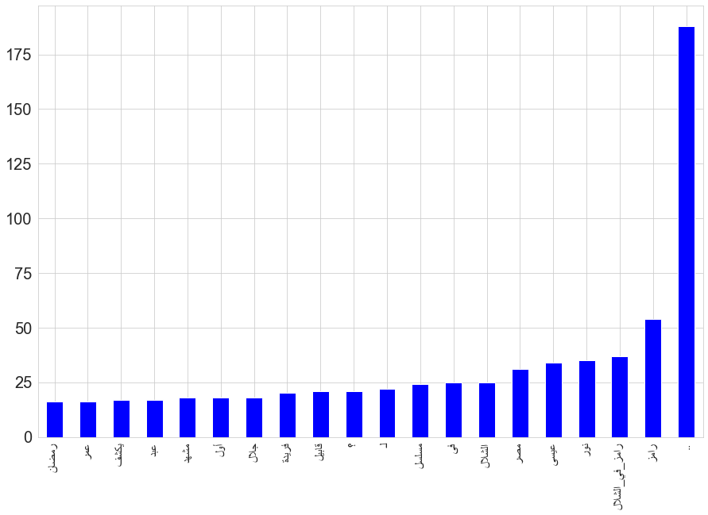
Popular words

Slide 22
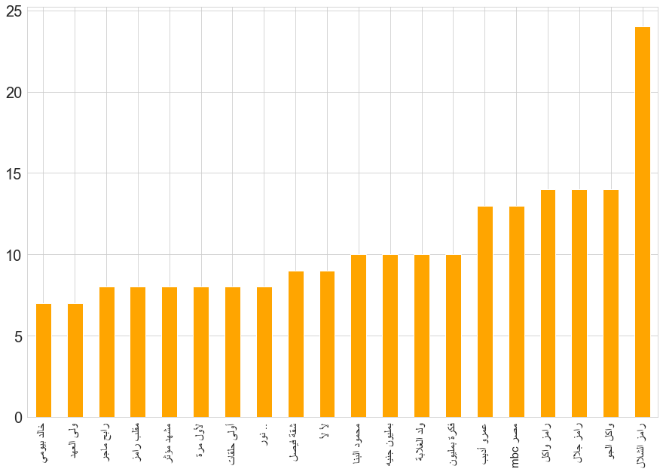
Popular trigrams

Slide 23
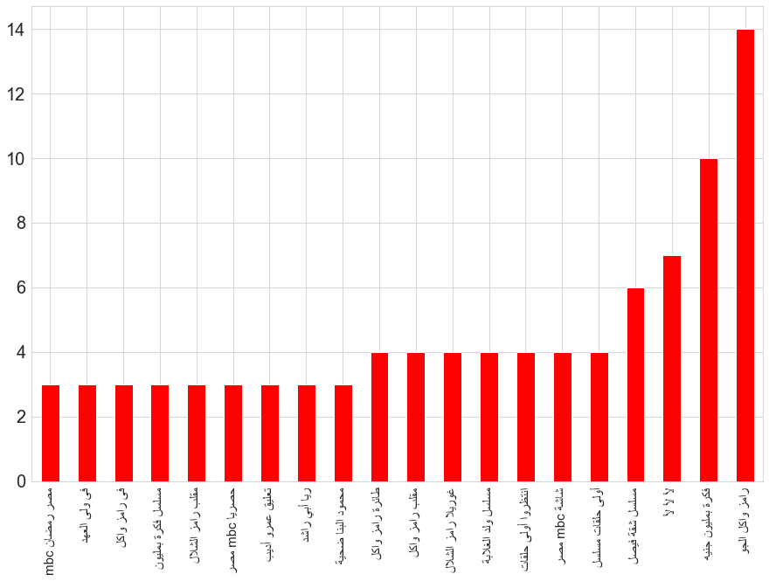
Popular trigrams

Slide 24
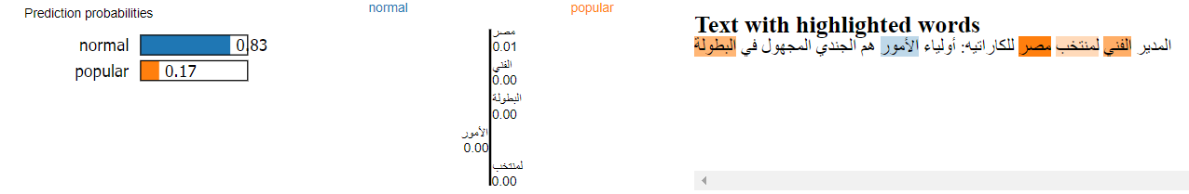
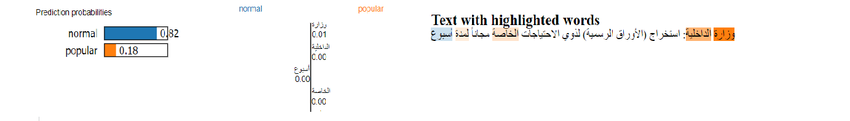
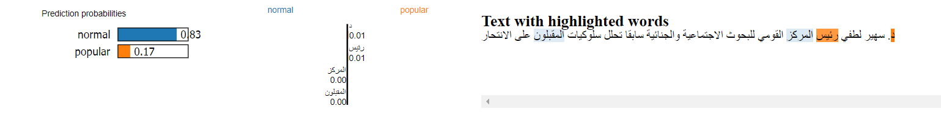
words that are distinctive

Slide 25
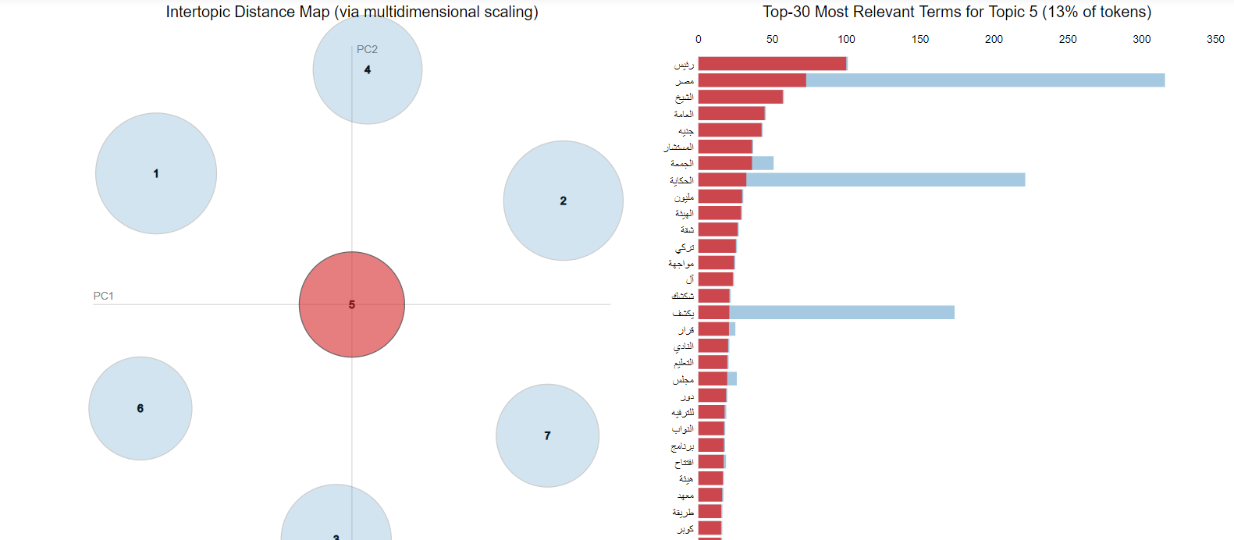
Top-30 Most Relevant Terms

Slide 26
Generating titles by lstm Model
This is just POC model used to generate title for provided topic based on popular words

